Slide 1


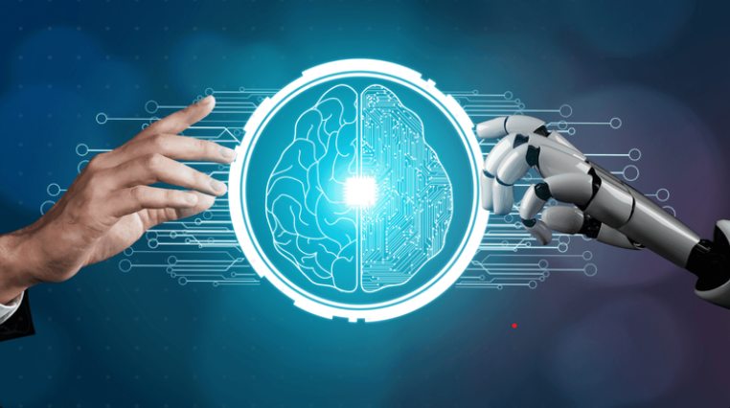
Medical Image Segmentation using U-Net:
A Deep Learning Approach to Organ and Tumor Segmentation---[BRAIN TUMOR]
TEAM MEMBERS:
JAYARAJ V [927622BAL017]
HARINI R [927622BAL012]
RAGHAVARDHINI T [927622BAL037]
SWATHI M [927622BAL047]
VIJAY P J [927622BAL054]

Slide 2
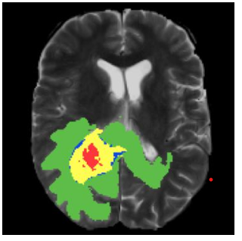
INTRODUCTION
Medical Image Segmentation
Medical Image Segmentation is a computer vision task that involves dividing an medical image into multiple segments, where each segment represents a different object or structure of interest in the image.
The goal of medical image segmentation is to provide a precise and accurate representation of the objects of interest within the image, typically for the purpose of diagnosis, treatment planning, and quantitative analysis.

Slide 3
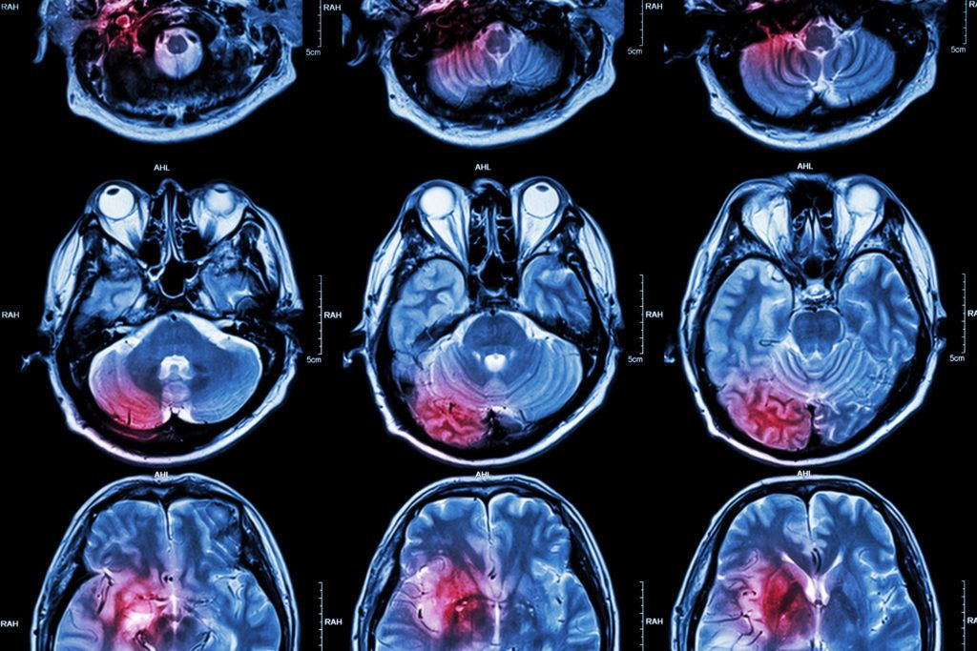
ABSTRACTION
Brain tumor segmentation in medical images is vital for diagnosis and treatment planning, yet automated techniques struggle with variability in imaging, anatomy, and complex boundaries.
Challenges like noise and low contrast demand advanced, robust models that generalize well.
Collaboration between clinicians and researchers is crucial to develop reliable solutions, leveraging deep learning advancements for better patient outcomes.

Slide 4
OBJECTIVE:
Achieve precise segmentation for enhanced diagnostic accuracy.
Automate segmentation to improve efficiency in clinical workflows.
Support targeted treatment planning with accurate organ and tumor delineation.
Ensure robustness across imaging modalities and patient demographics.
Develop a reproducible deep-learning pipeline for medical image segmentation

Slide 5
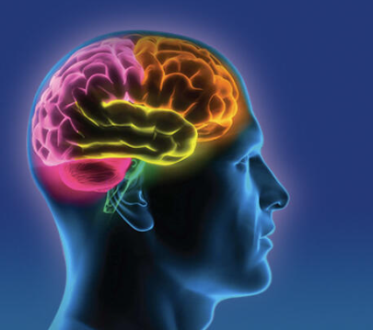
PROBLEM STATEMENT
Accurate identification and segmentation of Brain tumor boundaries in medical images is crucial for diagnosis and treatment.
Automated techniques struggle with image variability and complex anatomy.
Advancements in image processing, machine learning, and collaboration between clinicians and researchers are necessary for robust and reliable solutions, improving patient outcomes.

Slide 6
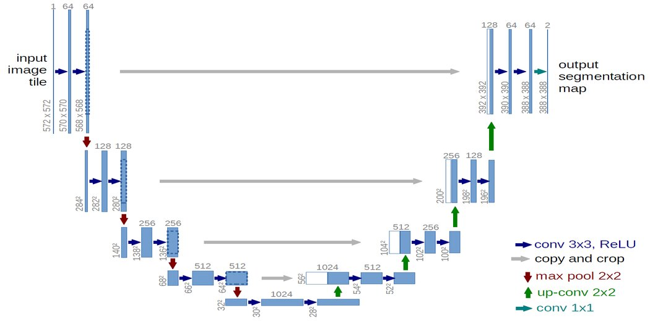
U-Net Architecture
U Net Architecture gets its name from its architecture.
The “U” shaped model comprises convolutional layers and two networks.
First is the encoder, which is followed by the decoder.
With the U-Net, we can solve the above two questions of segmentation: “what” and “where”.

Slide 7
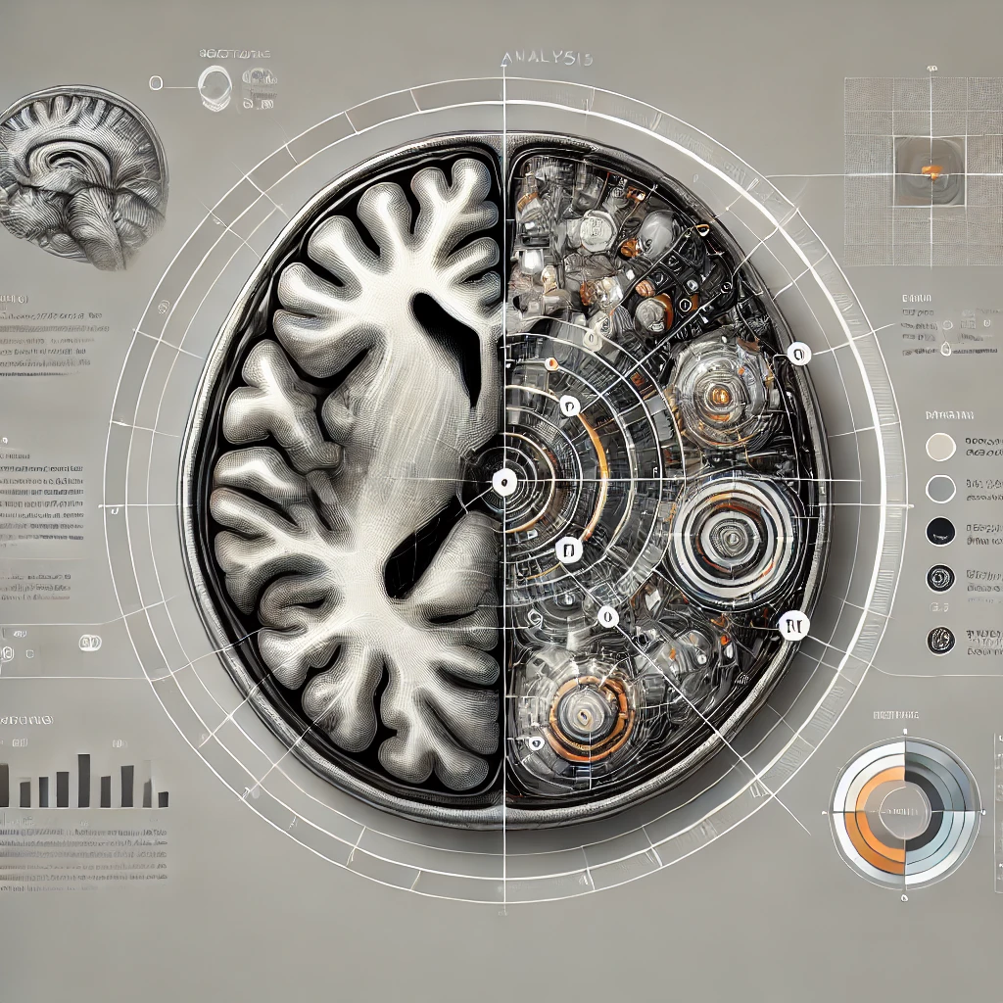
DATASET DETAILS
For brain tumor detection, the dataset should consist of MRI images with labels indicating the presence or absence of a tumor.
Brain Tumor MRI Dataset:
Available on Kaggle , containing images classified as "Tumor" or "No Tumor."
TCIA (The Cancer Imaging Archive):
Provides a variety of medical imaging datasets, often requiring preprocessing for specific analysis.
BRATS (Brain Tumor Segmentation Challenge):
An extensive dataset primarily for brain tumor segmentation but can be adapted for tumor classification.

Slide 8
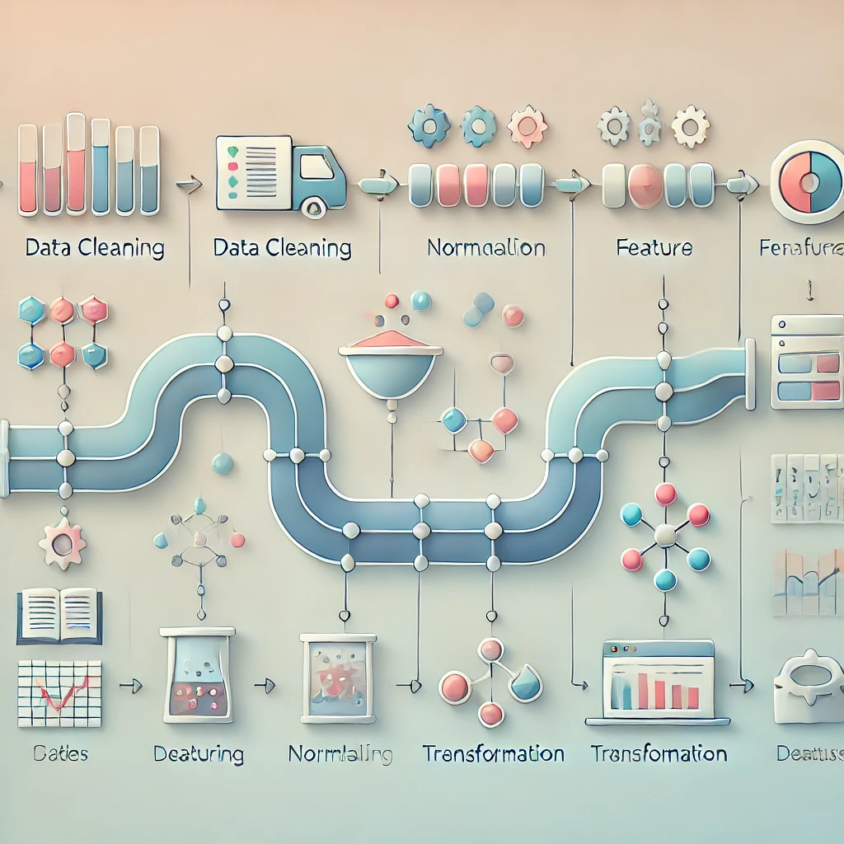
PRE-PROCESSING
Image preprocessing is essential for improving model performance.
Resizing:
Resize all images to a fixed size (e.g., 224x224 pixels) to match the input size of your model.
Normalization:
Scale pixel values to a [0, 1] range by dividing by 255. This helps the model train more effectively.
Grayscale Conversion (optional):
MRI scans are typically grayscale images. If your model is set up for grayscale, convert images appropriately.
Data Augmentation:
To improve model robustness, apply transformations such as:
Random rotations
Horizontal/Vertical flips
Zooming or shifting
Brightness adjustments

Slide 9
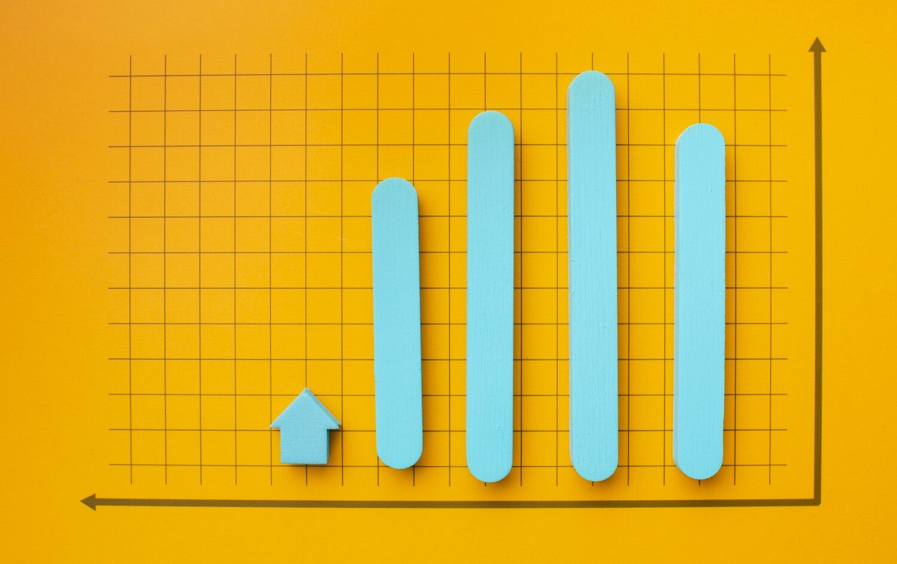
Model Evaluation
Accuracy:
Measures the percentage of correct predictions.
Precision:
The proportion of true positives among all positive predictions. Important for reducing false positives.
Recall (Sensitivity):
The proportion of true positives among actual positives. Important for minimizing false negatives.
F1 Score:
The harmonic mean of precision and recall. Balances both metrics.
Confusion Matrix:
Provides a summary of prediction outcomes, showing true positives, false positives, true negatives, and false negatives.

Slide 10
Visualization and Validation
Plotting the training and validation accuracy and loss over epochs helps visualize the model's learning progress and detect potential overfitting.
Additionally, visualize the ROC curve to analyze the model's performance at various classification thresholds.

Slide 11
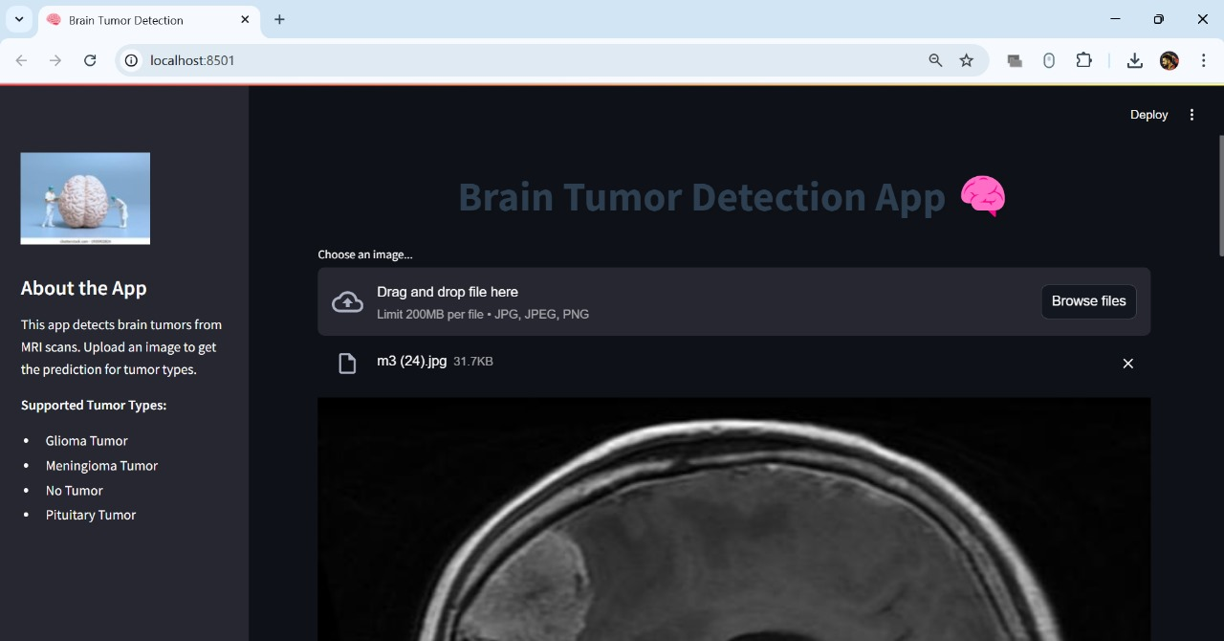
RESULT

Slide 12
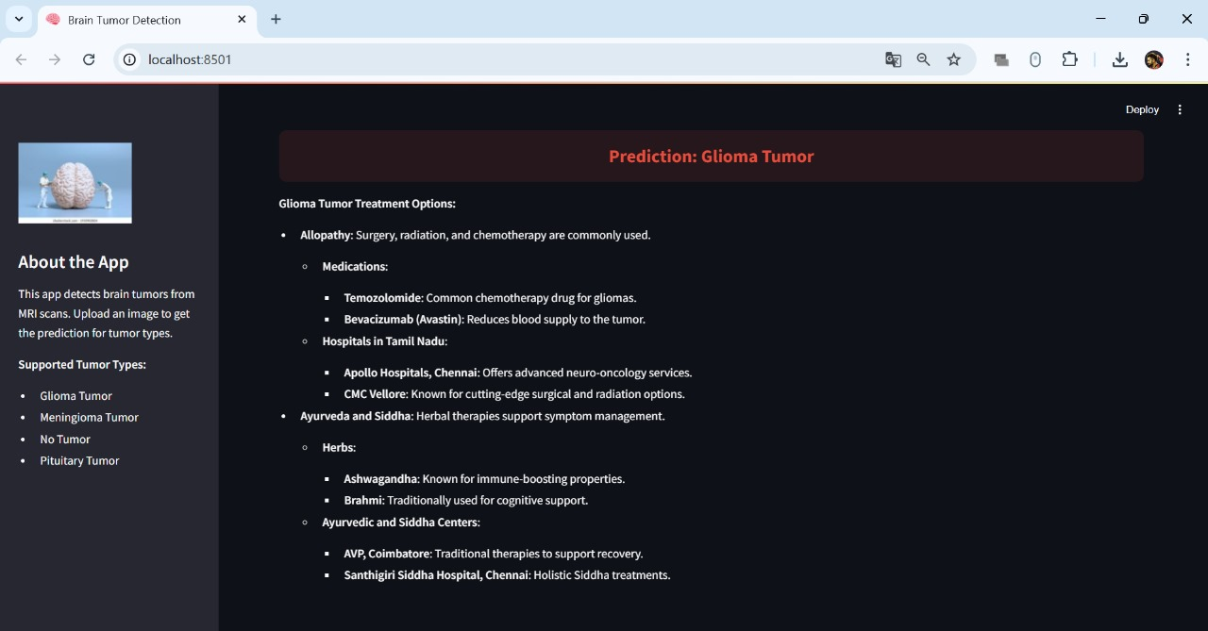

Slide 13
Proposed Solution :
The U-Net architecture is adapted for brain tumor classification by replacing the final layer with a Global Average Pooling and Dense layer for multi-class classification. Input images are resized, normalized, and processed for prediction. The model outputs the tumor type (glioma, meningioma, pituitary, or no tumor) with a confidence score. This approach ensures accurate classification, scalability, and robust feature extraction for medical imaging tasks.

Slide 14
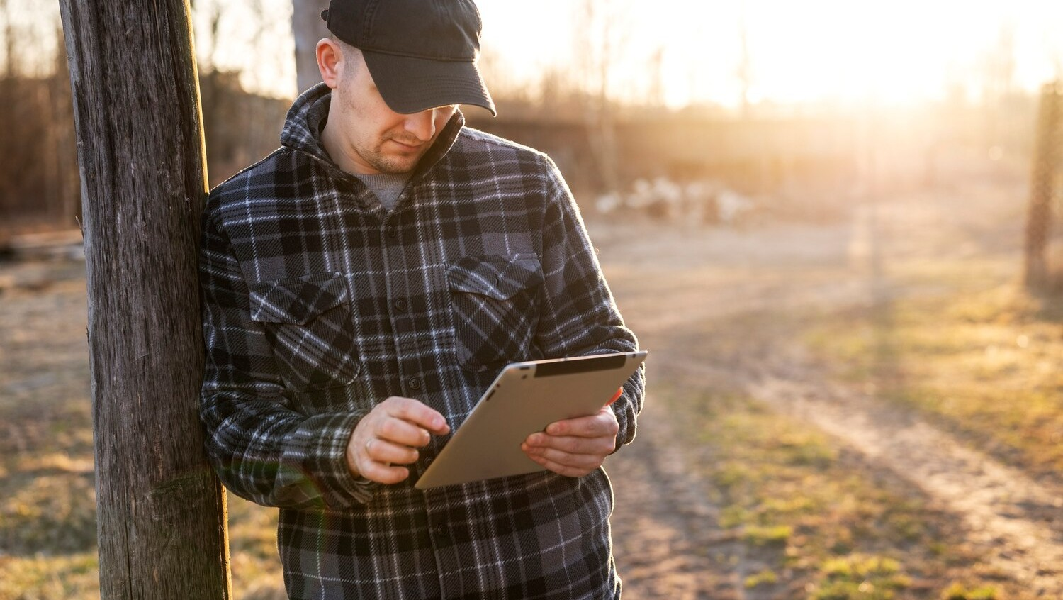
CONCLUSION
"In conclusion, leveraging deep learning CNN models enhances the accuracy and robustness of organ and tumor segmentation, addressing variability and complexity in medical images.
This approach supports more reliable diagnosis and treatment planning, ultimately improving patient outcomes.

Slide 15
Thanks!
Do you have any questions?

